Slide 1
Diffusion Model with SRV Boundary Conditions
Margherita

Slide 2
1) Read the UV-Vis raw data to get O.D. at wavelength of excitation
%Here we are reading an ABSORBANCE SPECTRA in .csv to extract the value of
%absorbance at a certain wavelength. Any csv file with first column wvl and
%second column abs values will work
absorbance_file_path = 'C:\Users\Margherita\OneDrive - UW\Documents\DATA\EDA_additive_work\09_17_21_UV_Vis_stab\1day\BR25.csv';
absorbance_data = readtable(absorbance_file_path,'NumHeaderLines',1); %change the number after 'NumHeaderLines' to account for the rows without usable data in your csv file
wavelengths = [400,650,730]; %excitation wavelength in nm
for i = 1:wavelengths_size(2); %for loop for each excitation wavelength
wavelength = wavelengths(i);
absorbance = interp1(table2array(absorbance_data(:, 1)),table2array(absorbance_data(:, 2)),wavelength); % value of absorbance at the wavlength of excitation

Slide 3


2) Set parameters for simulation
diffusion_pde_solver_1_wavelength.m / diffusion_pde_solver_multiple_wavelength.m
$$k_{nr}=1x{10}^{6} s^{−1}$$
$$k_{b}=4x{10}^{−11} cm/s$$
$$N_{C}\left(0\right)=1x{10}^{13}{cm}^{−1}$$
$SRV1=1x{10}^{3 }$ $cm/s$
$SRV2=1x{10}^{3 }$ $\frac{cm}{s}$
$$thickness=1x{10}^{3 }nm$$
$$D=0.04{ cm}^{2}/s$$
%here we put the list of the INITIAL VALUES OF THE VARIABLES
%constant values
diff_coeff = 0.04; %units of cm^2/s
mono_recomb_coeff = 1e6; %units of s^-1
bi_recomb_coeff = 4e-11; %units of cm/s
init_carrier_density = 1e13; %units of cm^-1
srv_1 = 1000; %units of cm/s
srv_2 = 1000; %units of cm/s
film_thickness = 1000; %in nm
% distance array: x values are a linear sequence (= linspace in python)
xmesh_step = 1; % distance step in nm. It is going to be in the middle of the min and max of the array (min:step:max) shpwn below
x = 0:(xmesh_step*1e-7):(film_thickness*1e-7); %units of cm, the lower and upper limit are the first and last value and the range is in the middle
%time array
t_step = 1e-10; % time step in s
t_simulate = 0:t_step:1e-7; %linspace(1*(10^-6), 5*(10^-6), 501) %units of s
$$t=0−100 ns$$
$$x =0−thickness cm$$

Slide 4
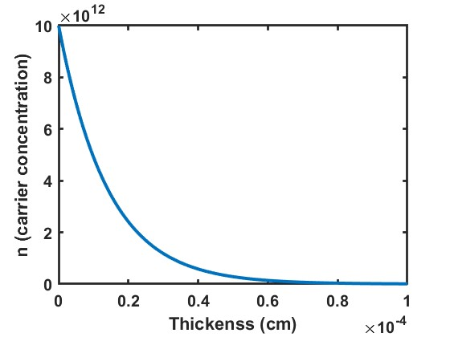
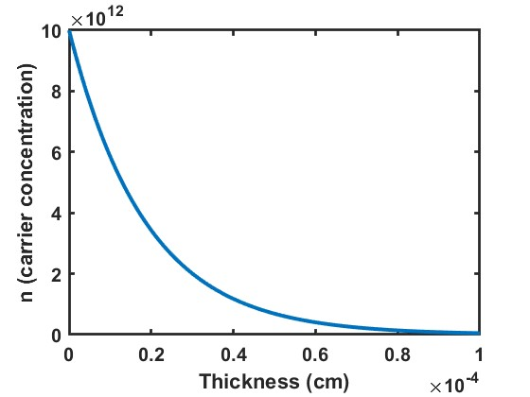
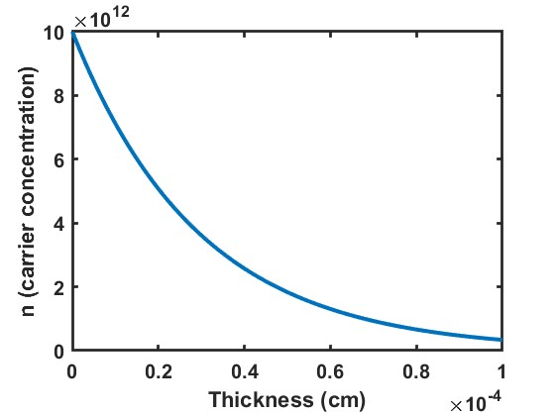
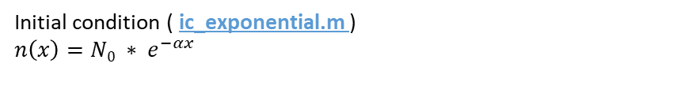
Initial condition ( ic_exponential.m )
$$n\left(x\right)=N0 ∗ e^{−αx}$$
function u0 = ic_exponential(x, N0, A, thickness);
% Exponential decay of initial carrier concentration as a function of the absorptance at the excitation wavelength
% thickness is in nm, gets converted to cm to be consistent with units of SRV parameter alpha is a function of excitation wavelength
alpha = (A / ((log10((exp(1)))* (thickness*1e-7)))); % A needs to be changed for exciation wavelength, x is the thickness
nc_init_func = N0 * exp(-alpha * x);
u0 = nc_init_func;
end
%Plot initial condition for excitation profile
figure
plot(x, ic_exponential(x, init_carrier_density, absorbance, film_thickness));
λ_{exc} = 400 nm
λ_{exc} = 640 nm
λ_{exc} = 700 nm

Slide 5
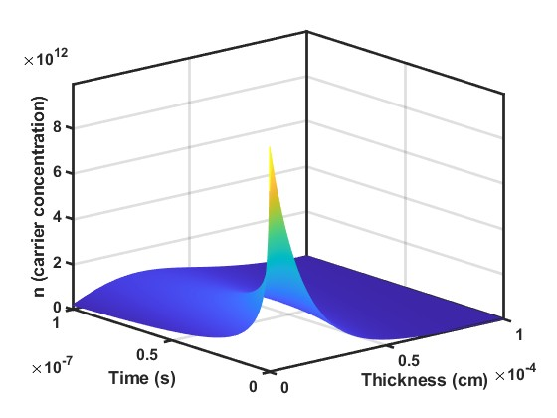
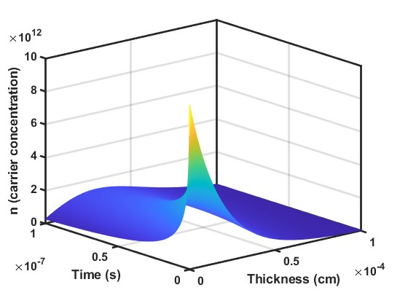
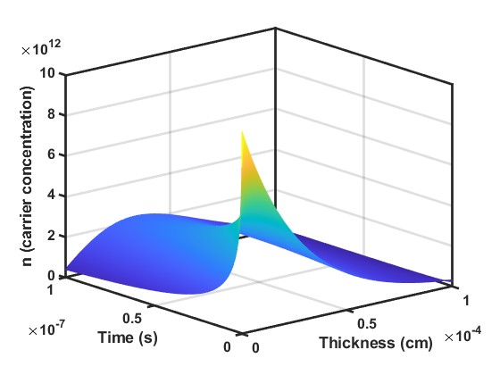

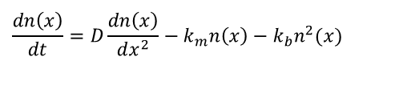
System of partial differential equation:
mono_bi_recomb_pde.m :
function [c,f,s] = mono_recomb_pde(x,t,u,DuDx, kr, kb, d)
c = 1;
f = d*DuDx;
s = -kr*u - kb*(u^2);
$$\frac{dn\left(x\right)}{dt}=D\frac{dn\left(x\right)}{dx^{2}}−k_{m}n\left(x\right)−k_{b}n^{2}(x)$$
SRV_fixed_bc.m :
$$D\frac{dn\left(x\right)}{dx^{2}}|x=0 = {−S}_{1}n(0)$$
$$D\frac{dn\left(x\right)}{dx^{2}}|x=d = S_{2}n(d)$$
function [pl,ql,pr,qr] = diff1dbc(xl,ul,xr,ur,t, s1, s2)
pl = -s1*ul;
ql = 1;
pr = s2*ur;
qr = 1;
sol = pdepe(0,@(x,t,u,DuDx)mono_bi_recomb_pde(x, t, u, DuDx, mono_recomb_coeff, bi_recomb_coeff, diff_coeff) ,@(x)ic_exponential(x, init_carrier_density, absorbance, film_thickness), @(xl, ul, xr, ur, t) SRV_fixed_bc(xl ,ul, xr, ur ,t , srv_1, srv_2), x, t_simulate);
% First input correspond to m values it defines symmetry of the parabolic elliptic pde for this equation is always equal 0 (https://www.mathworks.com/help/matlab/ref/pdepe.html#mw_077c5e49-ee92-4c2b-a988-c17d8d564362) section pdefun
figure
mesh(x, t_simulate, sol) % to get 3D graphic
λ_{exc} = 400 nm
λ_{exc} = 640 nm
λ_{exc} = 700 nm

Slide 6
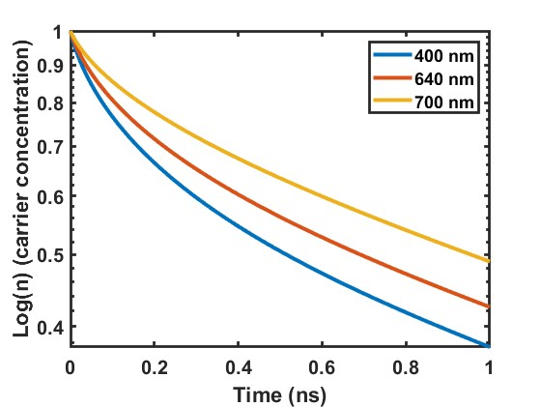
%Below is for loop to integrate solution over x for each time point
t_size = size(t_simulate); % find size of time array
n_integrate = zeros(1,t_size(2)); %create empty array to store x integrated solutions for each time point
for j = 1:t_size(2);
n_int = trapz(x, sol(j,:)); %integrate over x for time point j
n_integrate(1,j) = n_int; %store in array
end
figure
set(gca, 'YScale', 'log')
hold on
for i = 1:wavelengths_size(2);
%hold all
%semilogy(t_simulate, pl_x_integrated);
plot(t_simulate, n_integrate(i,:)/max(n_integrate(i,:)));
end

